Slide 1




MENTORS
Anushka Singh (CSE(AI&ML))
Rohan Rathi (CSE(AI&ML))
MEMBERS
Sameer Singh Rawat ( Team Lead) (Machine Learning)
Shubham Verma (Machine Learning)
Pooja Chauhan (Backend)
Satyam Singhal (Backend)
Harshit Verma (Frontend)
Devanshu Sharma (Frontend)

Slide 2











The FLAVOR FUSION
Problem Statement
The Flavor Fusion is a new startup restaurant in city . Many more and well
established restaurants are already ahead in the market race . Develop a
solution that boost its sales .
Solution
Creating a website for the restaurant for taking online orders and
deliver them to boost the sales .

Slide 3







Overview of our solution
In this problem, we encounter the challenge of increasing the sales of a newly startup restaurant to compete in the market with other well established restaurant. However, this obstacle can be addressed, and here's our plan to make it happen:
User-friendly website interface for the restaurant with the list of dishes on the Menu section of website .
Implementing an AI Bot to take orders from the customer .
Storing the order details in the backend for further process.

Slide 4





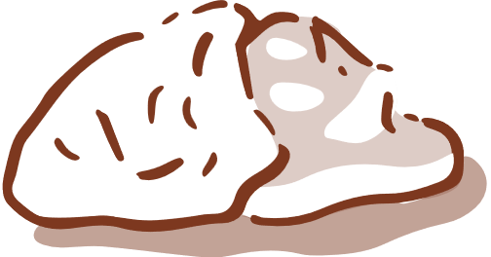
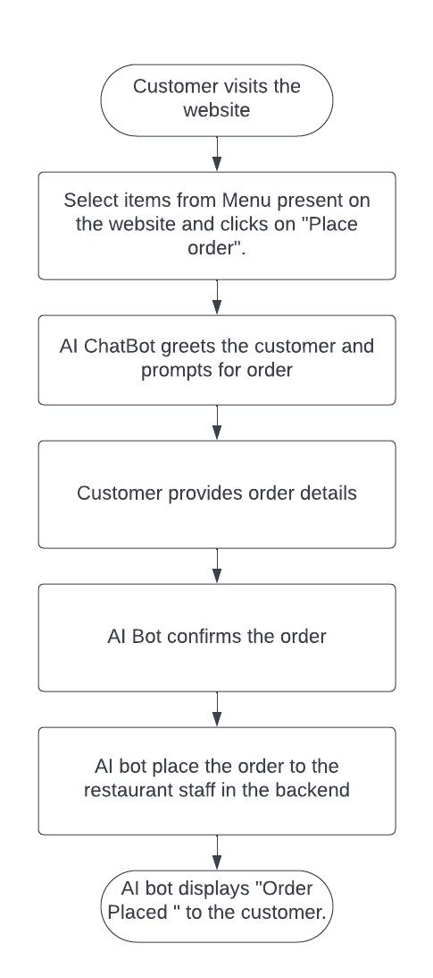






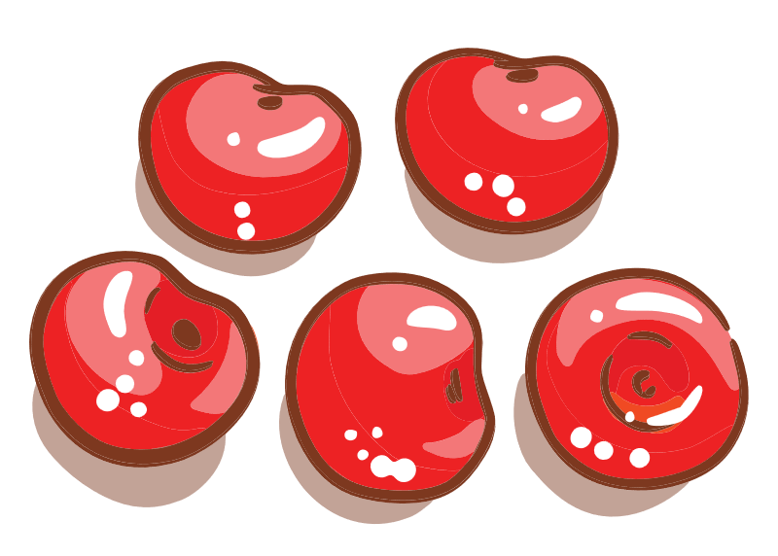


Workflow
Upon visiting the website, the customer will be able to see the details of restaurant including its location , ambience and dishes .
Website features a customer-selectable menu.Customer selects an order from the menu, then clicks "Place Order" to interact with the AI Chatbot to place the order .
Chatbot collects customer details (phone number , address , name), and places order in the backend.
We'll ensure the chat tab is prominently placed for easy access, minimizing confusion about the webpage's layout and features.

Slide 5



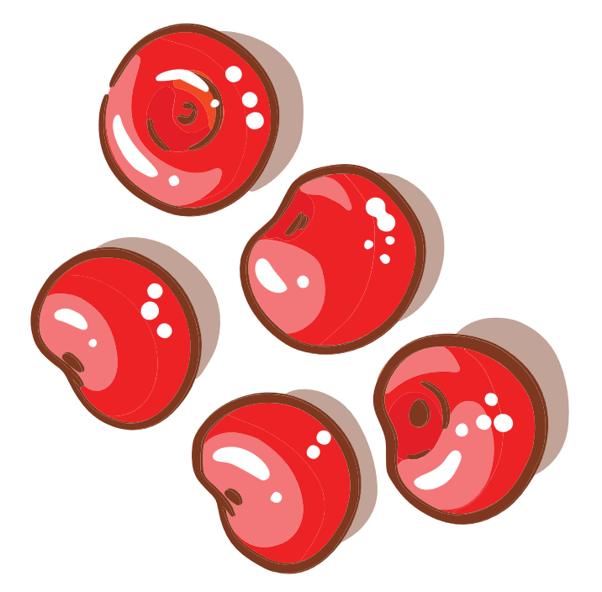

Tech Stack
Currently, we are aware that the services we intend to offer require a robust website, and for its efficient operation, we must employ high-quality software and tools that meet our specific needs. These include:
1. HTML5 ,CSS and JavaScript will be used for the frontend of the website.
2. Bootstrap will be used for making our website's user interface visually appealing and responsive.
3. My SQL and Flask Framework will be used in the backend.
4. Python and DialogFlow will be used for the development and implementation of the Chat Bot onto the website.

Slide 6










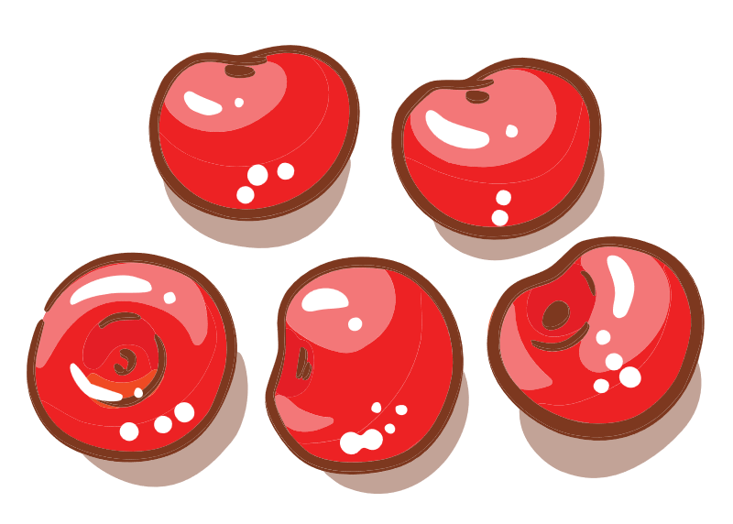


Thanks!
✉ shubham.2226cseml111@kiet.edu
✉ devanshu.2226cseml11@kiet.edu
✉ sameer.226cseml1117@kiet.edu
✉ satyam.2226cseml1124@kiet.edu
✉ harshit.2226cseml110@kiet.edu
✉ pooja.2226cseml1100@kiet.edu
icons by Flaticon and infographics & images by Freepik

